Slide 1
Relations and Their Properties

Slide 2
What is a relation
Let A and B be sets. A binary relation R is a subset of
A × B
Example
  Let A be the students in a the CS major
    A = {Alice, Bob, Claire, Dan}
  Let B be the courses the department offers
    B = {CS101, CS201, CS202}
  We specify relation R = A × B as the set that lists all students a ∈ A enrolled in class b ∈ B
  R = { (Alice, CS101), (Bob, CS201), (Bob, CS202),
  (Dan, CS201), (Dan, CS202) }

Slide 3
More relation examples
Another relation example:
  Let A be the cities in the US
  Let B be the states in the US
  We define R to mean a is a city in state b
  Thus, the following are in our relation:
    (C’ville, VA)
    (Philadelphia, PA)
    (Portland, MA)
    (Portland, OR)
    etc…
Most relations we will see deal with ordered pairs of integers

Slide 4
Example
Consider A = {1, 2, 3, 4} and B = {2, 5, 6}. Find AxB
Solution:
AxB = {(1,2),(1, 5), (1, 6), (2, 2), (2, 5), (2, 6), (3, 2), (3, 5), (3, 6), (4, 2), (4, 5) , (4,6)}
Define R: A -> B ={(a, b)| a> b} = {(3,2), (4, 2)} => R is a subset of AxB
A is called Domain
B is called Codomain
Range : elements of B which are related to elements of A

Slide 5
Representing relations
We can represent relations graphically:
We can represent relations in a table:
 | CS101 | CS201 | CS202
Alice | X
Bob |  | X | X
Claire
Dan |  | X | X
Alice
Bob
Claire
Dan
CS101
CS201
CS202
Not valid functions!

Slide 6
Relations vs. functions
Not all relations are functions
But consider the following function:
All functions are relations!
a
b
c
d
1
2
3
4

Slide 7
When to use which?
A function is used when you need to obtain a SINGLE result for any element in the domain
  Example: sin, cos, tan
A relation is when there are multiple mappings between the domain and the co-domain
  Example: students enrolled in multiple courses

Slide 8
Relations on a set
A relation on the set A is a relation from A to A
  In other words, the domain and co-domain are the same set
  We will generally be studying relations of this type

Slide 9
Relations on a set
Let A be the set { 1, 2, 3, 4 }
Which ordered pairs are in the relation R = { (a,b) | a divides b }
R = { (1,1), (1,2), (1,3), (1,4), (2,2), (2,4), (3,3), (4,4) }
1
2
3
4
1
2
3
4
R | 1 | 2 | 3 | 4
1 | X | X | X | X
2 |  | X |  | X
3 |  |  | X
4 |  |  |  | X

Slide 10
More examples
Consider some relations on the set Z
Are the following ordered pairs in the relation?
(1,1) (1,2) (2,1) (1,-1) (2,2)
R₁ = { (a,b) | a≤b }
R₂ = { (a,b) | a>b }
R₃ = { (a,b) | a=|b| }
R₄ = { (a,b) | a=b }
R₅ = { (a,b) | a=b+1 }
R₆ = { (a,b) | a+b≤3 }
X
X
X
X
X
X
X
X
X
X
X
X
X
X
X

Slide 11
Relation properties
Six properties of relations we will study:
  Reflexive
  Irreflexive
  Symmetric
  Asymmetric
  Antisymmetric
  Transitive

Slide 12
Reflexivity
A relation is reflexive if every element is related to itself
  Or, (a,a)∈R
Examples of reflexive relations:
  =, ≤, ≥
Examples of relations that are not reflexive:
  <, >

Slide 13
Irreflexivity
A relation is irreflexive if every element is not related to itself
  Or, (a,a)∉R
  Irreflexivity is the opposite of reflexivity
Examples of irreflexive relations:
  <, >
Examples of relations that are not irreflexive:
  =, ≤, ≥

Slide 14
Reflexivity vs. Irreflexivity
A relation can be neither reflexive nor irreflexive
  Some elements are related to themselves, others are not
We will see an example of this later on

Slide 15
Symmetry
A relation is symmetric if, for every (a,b)∈R, then (b,a)∈R
Examples of symmetric relations:
  =, isTwinOf()
Examples of relations that are not symmetric:
  <, >, ≤, ≥

Slide 16
Asymmetry
A relation is asymmetric if, for every (a,b)∈R, then (b,a)∉R
  Asymmetry is the opposite of symmetry
Examples of asymmetric relations:
  <, >
Examples of relations that are not asymmetric:
  =, isTwinOf(), ≤, ≥

Slide 17
Antisymmetry
A relation is antisymmetric if, for every (a,b)∈R, then (b,a)∈R is true only when a=b
  Antisymmetry is not the opposite of symmetry
Examples of antisymmetric relations:
  =, ≤, ≥
Examples of relations that are not antisymmetric:
  <, >, isTwinOf()

Slide 18
Notes on *symmetric relations
A relation can be neither symmetric or asymmetric
  R = { (a,b) | a=|b| }
  This is not symmetric
    -4 is not related to itself
  This is not asymmetric
    4 is related to itself
  Note that it is antisymmetric

Slide 19
Transitivity
A relation is transitive if, for every (a,b)∈R and (b,c)∈R, then (a,c)∈R
If a < b and b < c, then a < c
  Thus, < is transitive
If a = b and b = c, then a = c
  Thus, = is transitive

Slide 20
Transitivity examples
Consider isAncestorOf()
  Let Alice be Bob’s parent, and Bob be Claire’s parent
  Thus, Alice is an ancestor of Bob, and Bob is an ancestor of Claire
  Thus, Alice is an ancestor of Claire
  Thus, isAncestorOf() is a transitive relation
Consider isParentOf()
  Let Alice be Bob’s parent, and Bob be Claire’s parent
  Thus, Alice is a parent of Bob, and Bob is a parent of Claire
  However, Alice is not a parent of Claire
  Thus, isParentOf() is not a transitive relation

Slide 21
Relations of relations summary
 | = | < | > | ≤ | ≥
Reflexive | X |  |  | X | X
Irreflexive |  | X | X
Symmetric | X
Asymmetric |  | X | X
Antisymmetric | X |  |  | X | X
Transitive | X | X | X | X | X

Slide 22
Combining relations
There are two ways to combine relations R₁ and R₂
  Via Boolean operators
  Via relation “composition”

Slide 23
Combining relations via Boolean operators
Consider two relations R≥ and R≤
We can combine them as follows:
  R≥ U R≤ = all numbers ≥ OR ≤
    That’s all the numbers
  R≥ ∩ R≤ = all numbers ≥ AND ≤
    That’s all numbers equal to
  R≥ ⊕ R≤ = all numbers ≥ or ≤, but not both
    That’s all numbers not equal to
  R≥ - R≤ = all numbers ≥ that are not also ≤
    That’s all numbers strictly greater than
  R≤ - R≥ = all numbers ≤ that are not also ≥
    That’s all numbers strictly less than
Note that it’s possible the result is the empty set

Slide 24
Combining relations via relational composition
Let R be a relation from A to B, and S be a relation from B to C
  Let a ∈ A, b ∈ B, and c ∈ C
  Let (a,b) ∈ R, and (b,c) ∈ S
  Then the composite of R and S consists of the ordered pairs (a,c)
    We denote the relation by S ◦ R
    Note that S comes first when writing the composition!

Slide 25
Combining relations via relational composition
Let M be the relation “is mother of”
Let F be the relation “is father of”
What is M ◦ F?
  If (a,b) ∈ F, then a is the father of b
  If (b,c) ∈ M, then b is the mother of c
  Thus, M ◦ F denotes the relation “maternal grandfather”
What is F ◦ M?
  If (a,b) ∈ M, then a is the mother of b
  If (b,c) ∈ F, then b is the father of c
  Thus, F ◦ M denotes the relation “paternal grandmother”
What is M ◦ M?
  If (a,b) ∈ M, then a is the mother of b
  If (b,c) ∈ M, then b is the mother of c
  Thus, M ◦ M denotes the relation “maternal grandmother”
Note that M and F are not transitive relations!!!

Slide 26
Combining relations via relational composition
Given relation R
  R ◦ R can be denoted by R²
  R² ◦ R = (R ◦ R) ◦ R = R³
  Example: M³ is your mother’s mother’s mother

Slide 27
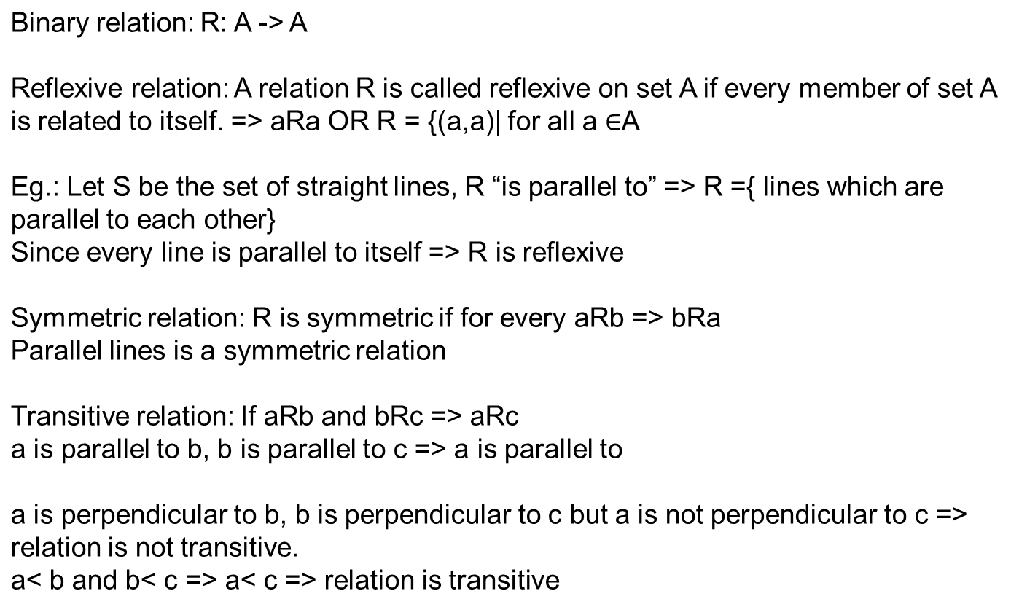
Types of Relations

Slide 28
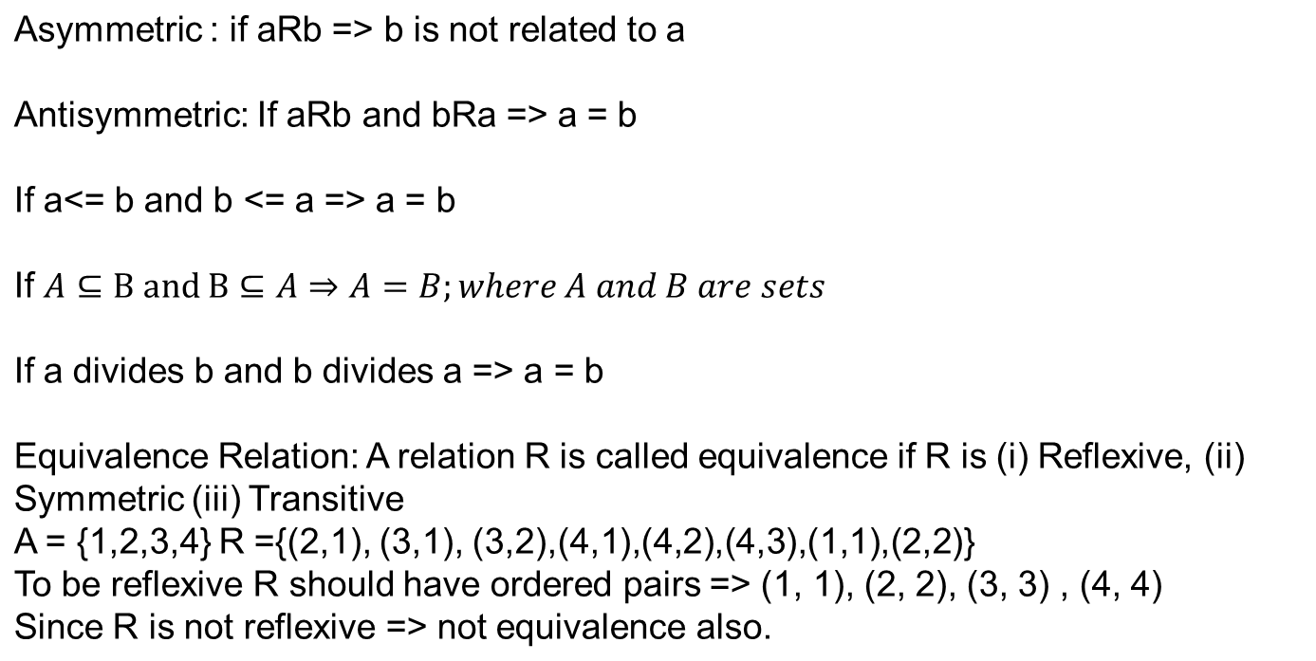

Slide 29
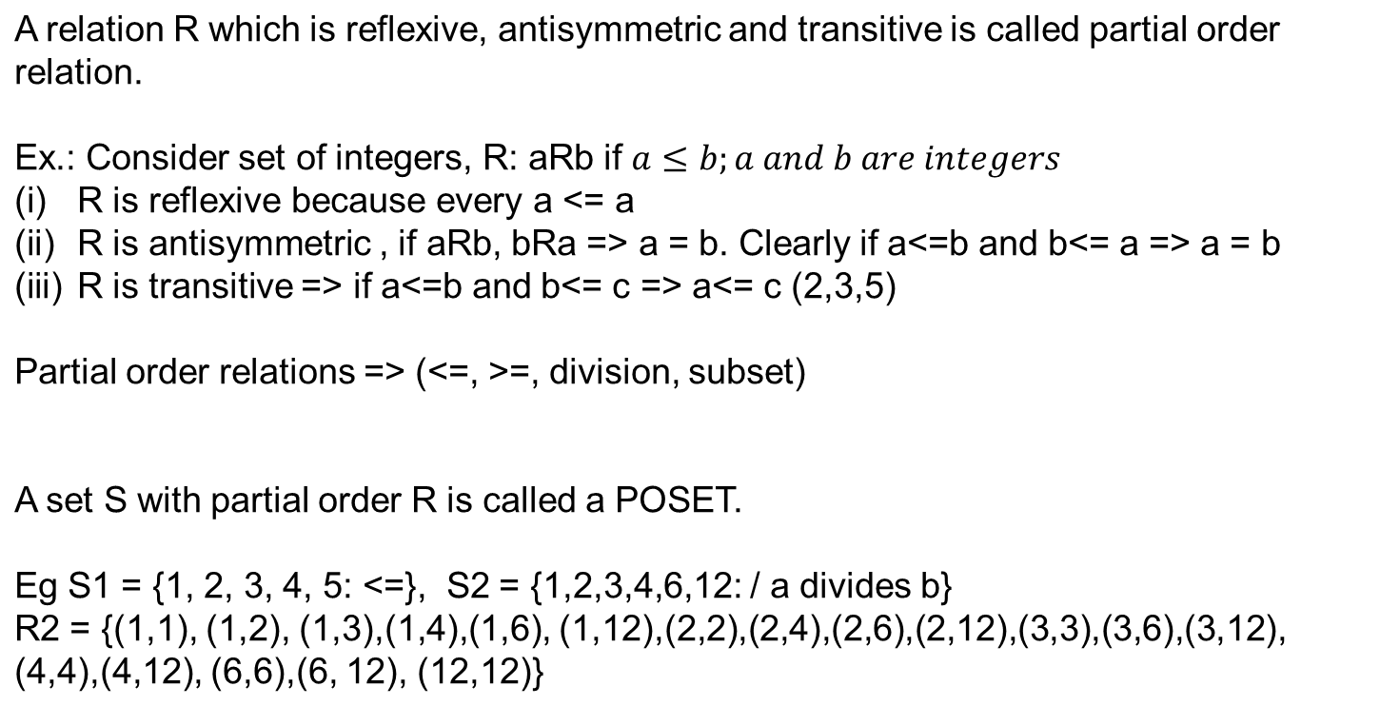
Partial Order relation

Slide 30
Hasse Diagram: to represent POSET
{a, b, c}
How to show relation: Bottom to top
POSET -> {1, 2, 3, 4, 6, 12: a divides b}
{a,b}
{c,b}
12
{a, c}
4
{a}
{c}
{b}
6
{ }
2
3
Let S = {a, b, c}
P(S) with relation of subset is a POSET
1

Slide 31
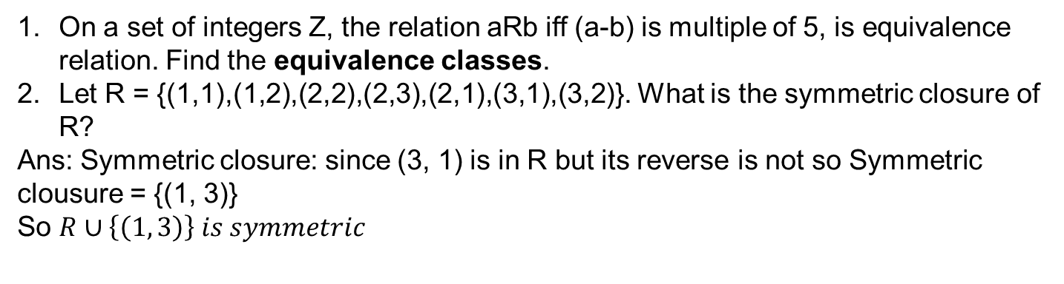
Questions from Old Paper

Slide 32
Equivalence Classes
Let R be the equivalence relation on a set A. Then the equivalence classes for any element x belongs to A is:
[x] = {y: xRy}; for all x belongs to set A
Let A = {1,2,3} and R is the equivalence relation over A.
R = {(1,1),(3,3),(1,2),(2,2),(2,3),(2,1),(3,1),(3,2), (1,3)}.
Equivalence Classes:
[1] = {y: 1Ry} = {1, 2, 3}
[2] = {1, 2, 3}
[3] = {1, 2, 3}

Slide 33
On a set of integers Z, the relation aRb iff (a-b) is multiple of 5, Show that R is equivalence relation. Find the equivalence classes.
To show that R is equivalence, we need to show that R is (i) Reflexive, (ii) symmetric and (iii) Transitive
aRb => (a-b) is multiple of 5 => (a – b) = 5k, k is any integer
reflexive: cleary (a - a) = 0 = 5*0 = 5.k => k = 0 and 0 is an integer => aRa => R is reflexive.
Symmetric: let aRb => (a – b) = 5k => (-b + a) = 5k => -(-b +a) = -5k=> (b – a) = 5.(-k) => (b – a) is a multiple of 5 => bRa => R is symmetric.
Transitive: Let aRb and bRc => ( a- b) = 5k and (b – c) = 5k’, add the two
(a – b) + (b – c) = 5(k + k’) => a – c = 5k” , k” = k + k’ is an integer=> aRc
R is transitive
Since R is reflexive, symmetric and Transitive, it is equivalence relation.
Let Z = { …., -3, -2, -1, 0, 1, 2, 3,….}
[0] = {x: 0Rx=> (0 – x) = 5k} => -x = 5k=> x = -5k => {0, +-5, +-10, +-15,…}
[1] = {x: 1Rx => (1 –x) = 5k => x = 1-5k} ={1, -4, 6, 11, -9, -14, 16, ..}
={ ..,-14, -9, -4,1, 6, 11, 16, ..}=[6]
[2] = {…., -13, -8, -3, 2, 7, 12, 17,..}; [3] = {…, -12, -7, -2, 3, 8, 13,…}
[4] = {…, -11,-6,-1, 4, 9, 14, ..} ; [5] = {…, -10, -5, 0, 5, 10, 15, ..} = [0]
Partition of Z b y R = {[0], [1], [2], [3], [4]}

